Slide 1
Bank Loan Case Study
Victor Shah

Slide 2
Project Description
As a data analyst at a finance company that specializes in lending various types of loans to urban customers, my primary responsibility is about using Exploratory Data Analysis (EDA) to analyze patterns in the data and ensure that capable applicants are not rejected.
Some of the challenges faced by the company are : some customers who don’t have a sufficient credit history take advantage of this and default on their loans.

Slide 3
Approach
Downloading the dataset: The first step is downloading the excel file (.csv) into the local device. Make sure the downloaded file is having the extension (.xlsx)
Understanding the worksheet: The next step is to examine the structure of the table holding the data in the Excel Sheet. (application_data.csv, columns_description.csv, previous_application.csv)
Identifying the key tables: Identification of the primary key from the dataset of excel files.

Slide 4
Data Cleaning: This is the preprocessing step that makes the data suitable for analysis. It includes handling missing values, removing duplicates.
Analyzing the four possible outcomes:
Approved: The company has approved the loan application.
Cancelled: The customer cancelled the application during the approval process.
Refused: The company rejected the loan.
Unused Offer: The loan was approved but the customer did not use it.
Data Visualization: To use EDA to understand how customer attributes and loan attributes influence the likelihood of default.

Slide 5
DATA ANALYTICS TASKS

Slide 6
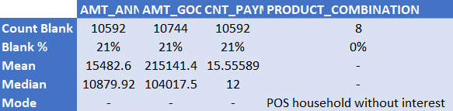
A. Identify Missing Data and Deal with it Appropriately:
Identify the missing data in the dataset and decide on an appropriate method to deal with it using Excel built-in functions and features.
Missing Data for the dataset application_data.csv
Missing Data for the dataset previous_application.csv

Slide 7
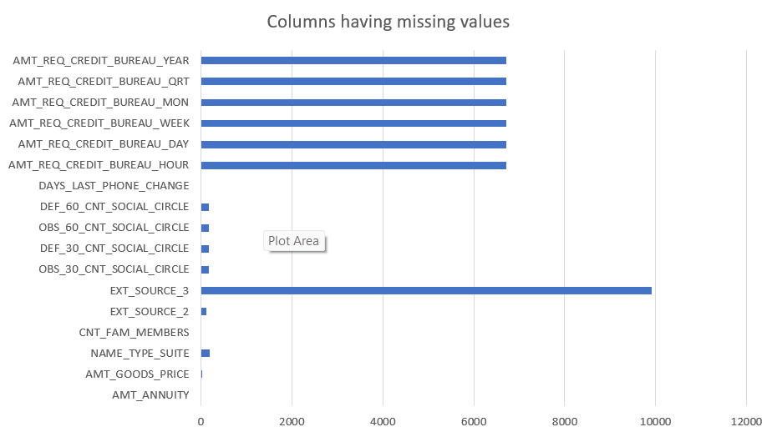
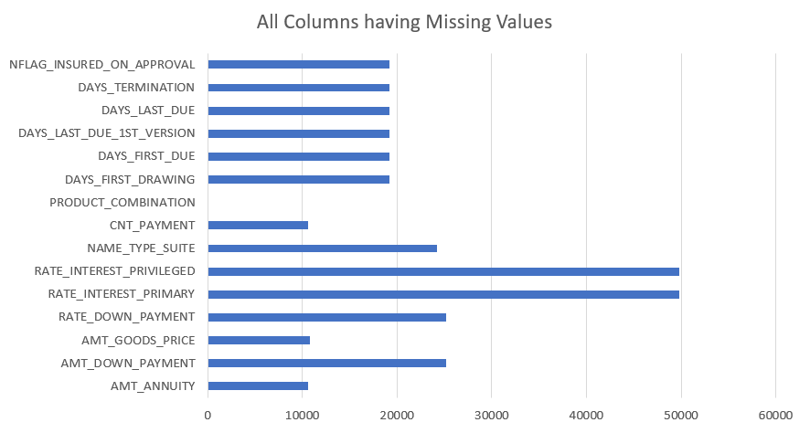
Create a bar chart or column chart to visualize the proportion of missing values for each variable.
Missing Data Visualization for:
dataset application_data.csv previous_application.csv

Slide 8
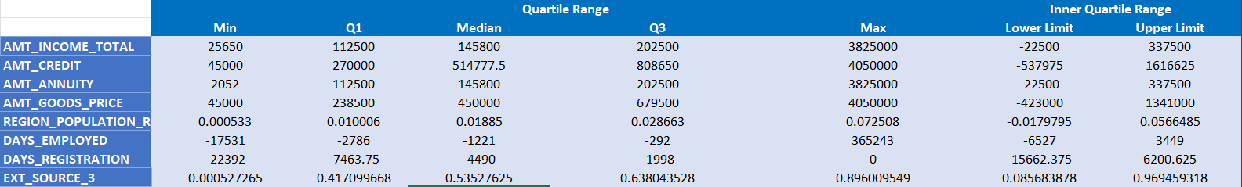
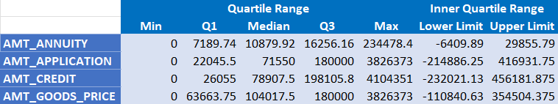
B. Identify Outliers in the Dataset:
Detect and identify outliers in the dataset using Excel statistical functions and features, focusing on numerical variables.
Outlier check representation table for the dataset application_data.csv
Outlier check representation table for the dataset previous_application.csv

Slide 9
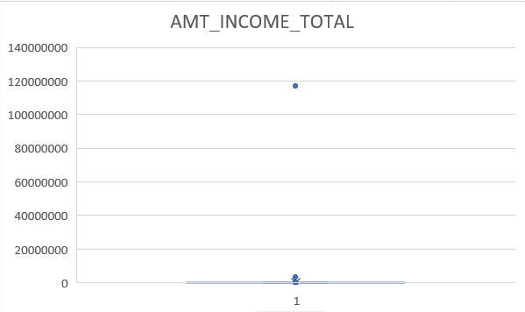
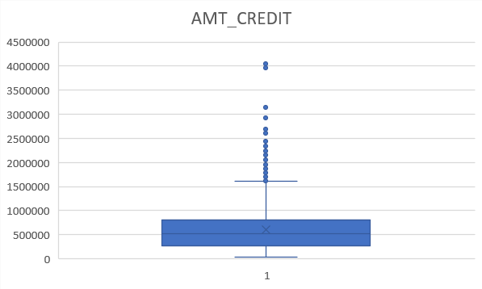
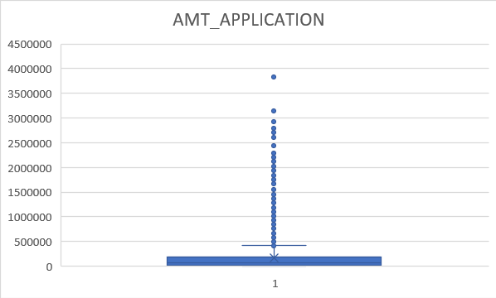
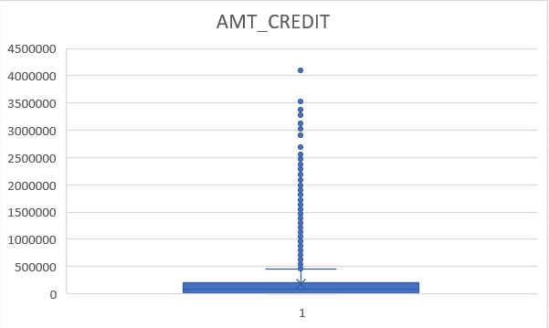
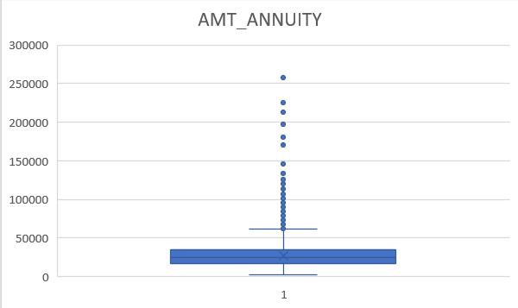
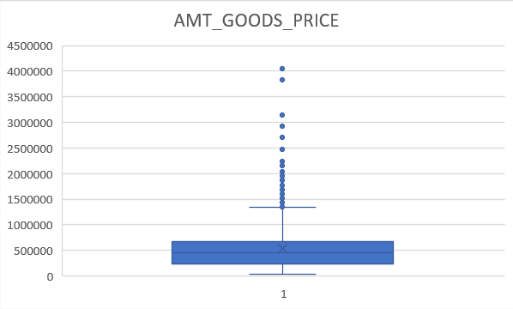
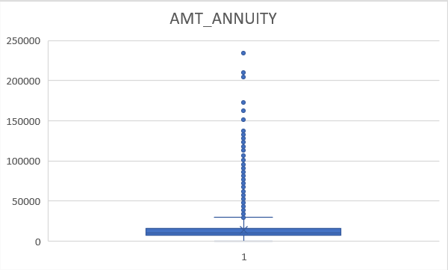
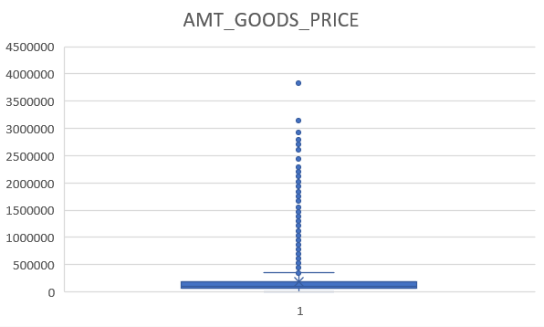
Create box plots or scatter plots to visualize the distribution of numerical variables and highlight the outliers.
Data Visualization for:
dataset application_data.csv previous_application.csv

Slide 10
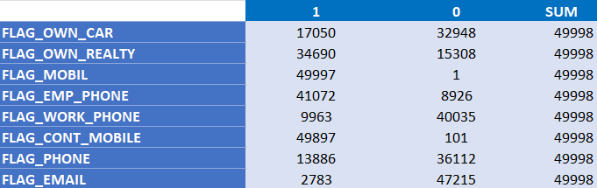
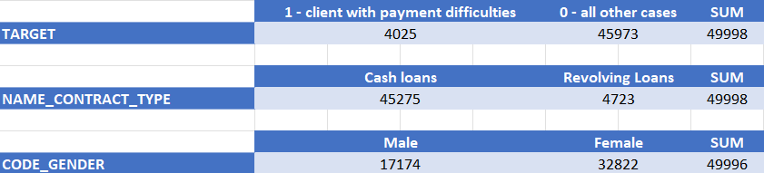
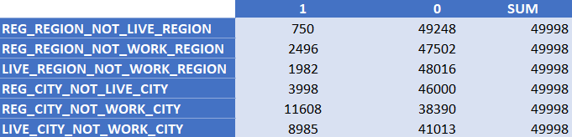
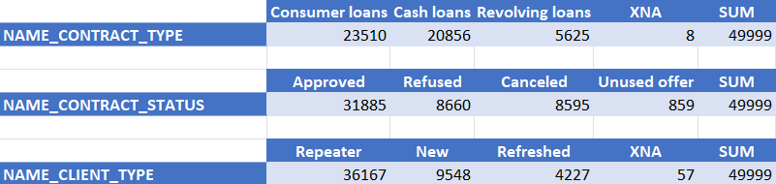
C. Analyze Data Imbalance:
Determine if there is data imbalance in the loan application dataset and calculate the ratio of data imbalance using Excel functions.
Data Imbalance check representation table for the dataset application_data.csv
Data Imbalance check representation table for the dataset previous_application.csv

Slide 11
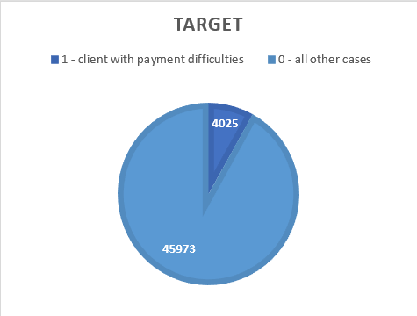
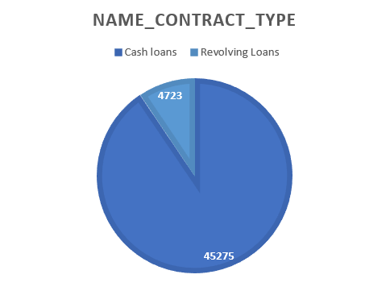
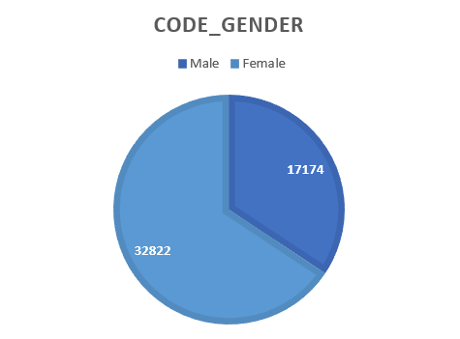
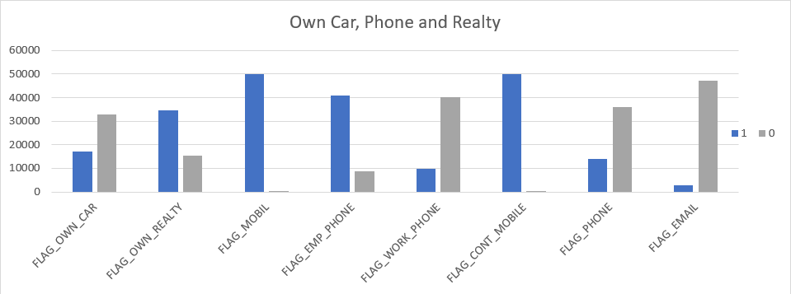
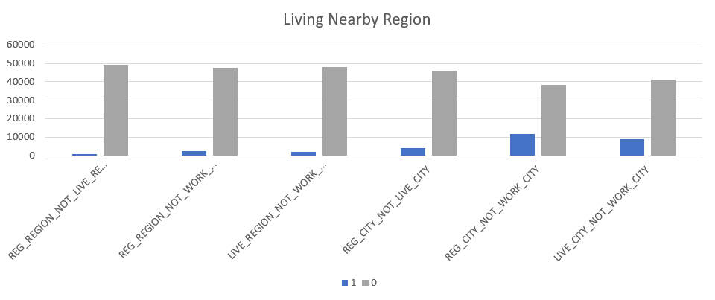
Create a pie chart or bar chart to visualize the distribution of the target variable and highlight the class imbalance.
dataset application_data.csv

Slide 12
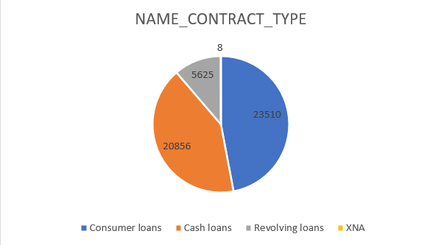
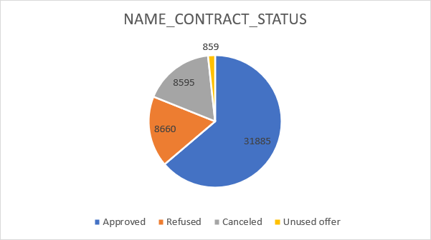
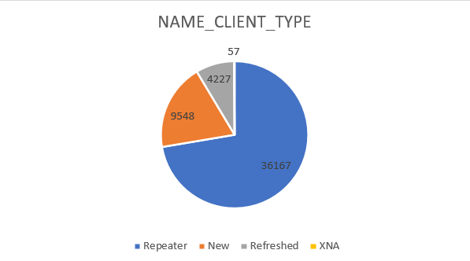
Create a pie chart or bar chart to visualize the distribution of the target variable and highlight the class imbalance.
previous_application.csv

Slide 13
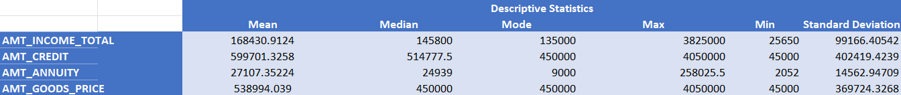
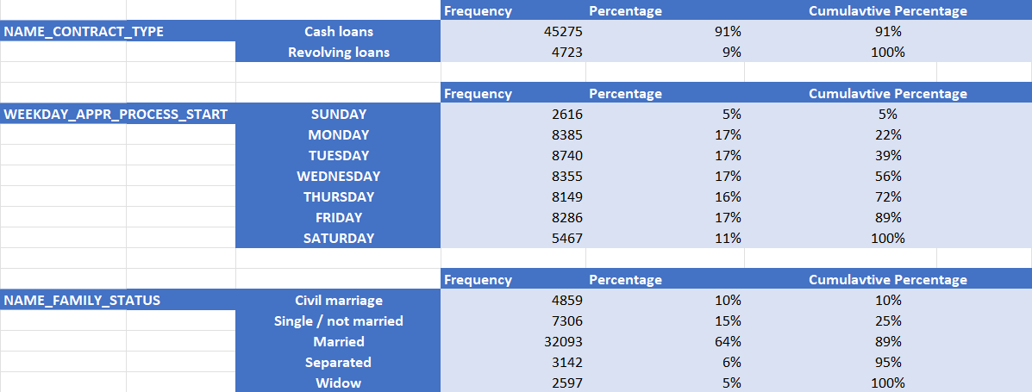
D. Perform Univariate, Segmented Univariate, and Bivariate Analysis:
Perform univariate analysis to understand the distribution of individual variables, segmented univariate analysis to compare variable distributions for different scenarios, and bivariate analysis to explore relationships between variables and the target variable using Excel functions and features.
Performing Univariate Analysis on application_data.csv

Slide 14
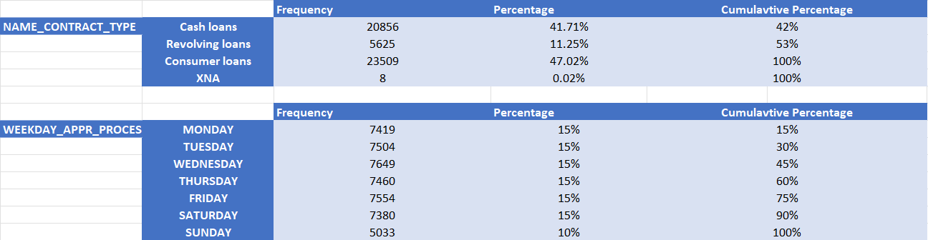
Performing Univariate Analysis on previous_application.csv

Slide 15
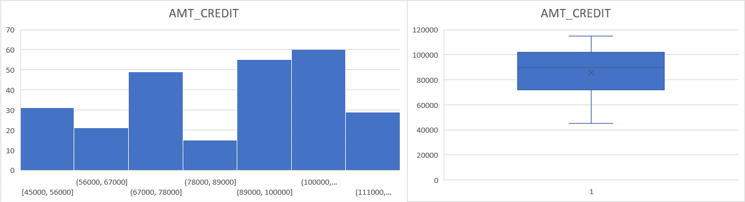
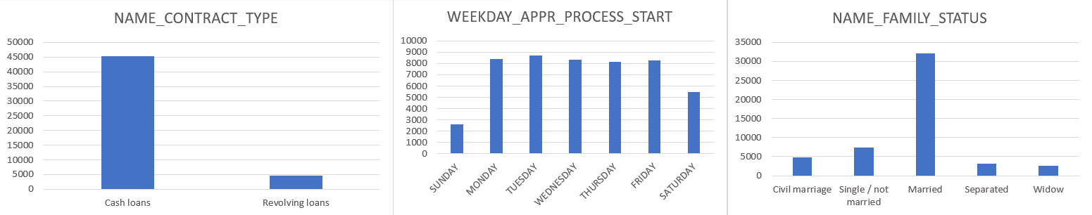
Create histograms, bar charts, or box plots to visualize the distributions of variables. Create stacked bar charts or grouped bar charts to compare variable distributions across different scenarios. Create scatter plots or heatmaps to visualize the relationships between variables and the target variable.
Data Visualization for application_data.csv

Slide 16
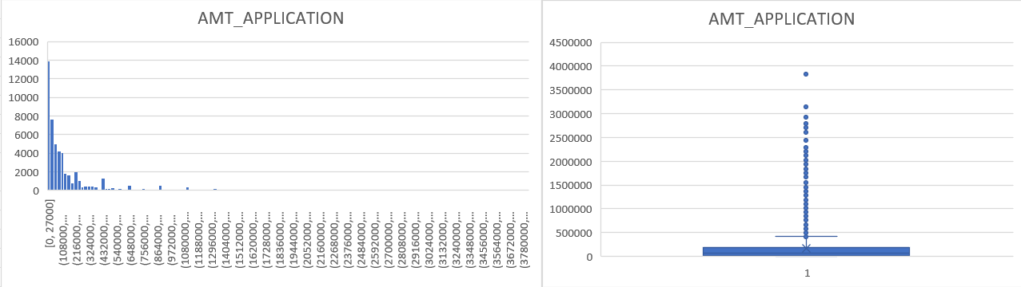
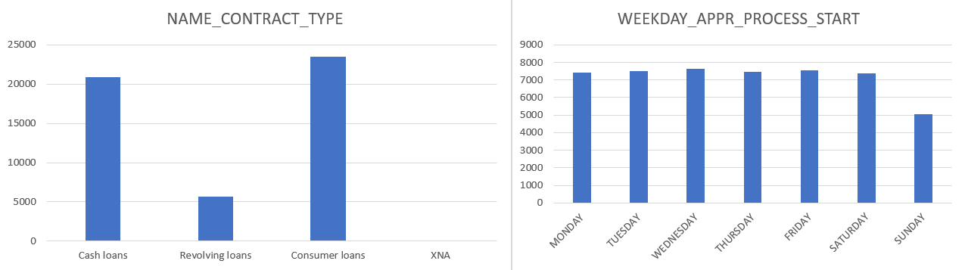
Create histograms, bar charts, or box plots to visualize the distributions of variables. Create stacked bar charts or grouped bar charts to compare variable distributions across different scenarios. Create scatter plots or heatmaps to visualize the relationships between variables and the target variable.
Data Visualization for previous_application.csv

Slide 17
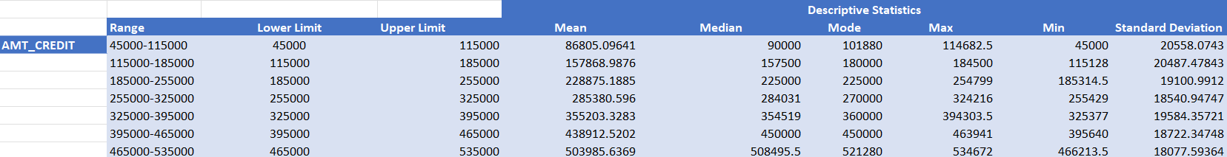
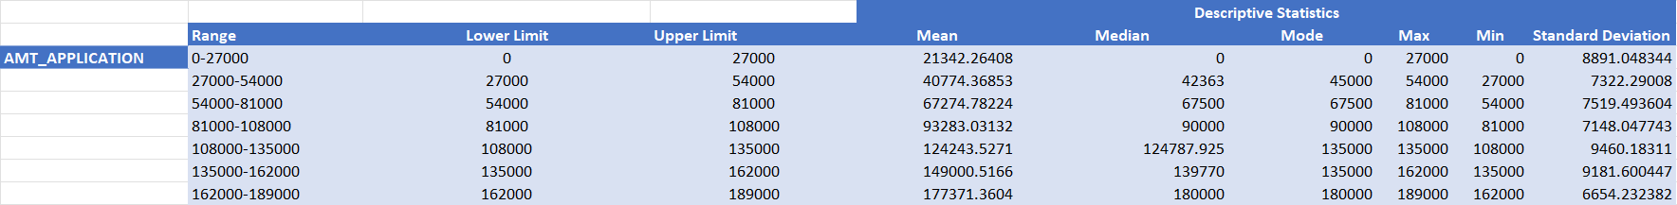
Performing Segmented Univariate Analysis on application_data.csv
Performing Segmented Univariate Analysis on previous_application.csv

Slide 18
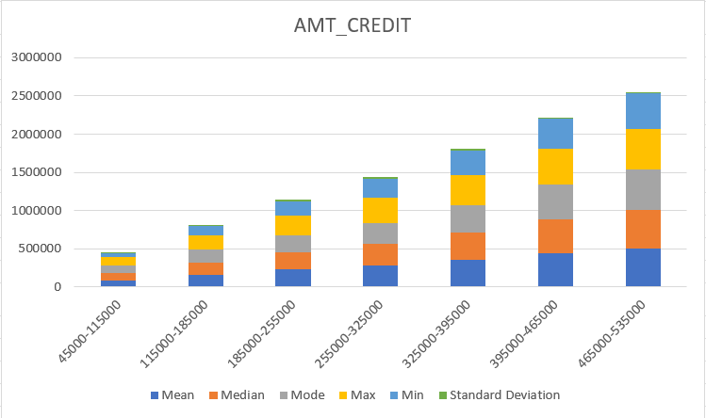
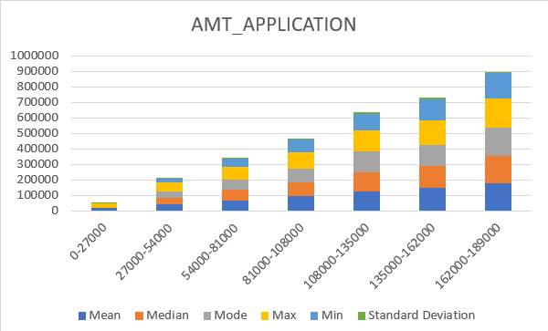
Create histograms, bar charts, or box plots to visualize the distributions of variables. Create stacked bar charts or grouped bar charts to compare variable distributions across different scenarios. Create scatter plots or heatmaps to visualize the relationships between variables and the target variable.
Data Visualization for
application_data.csv previous_application.csv

Slide 19
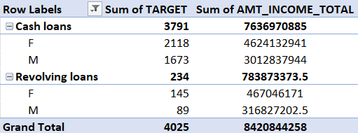
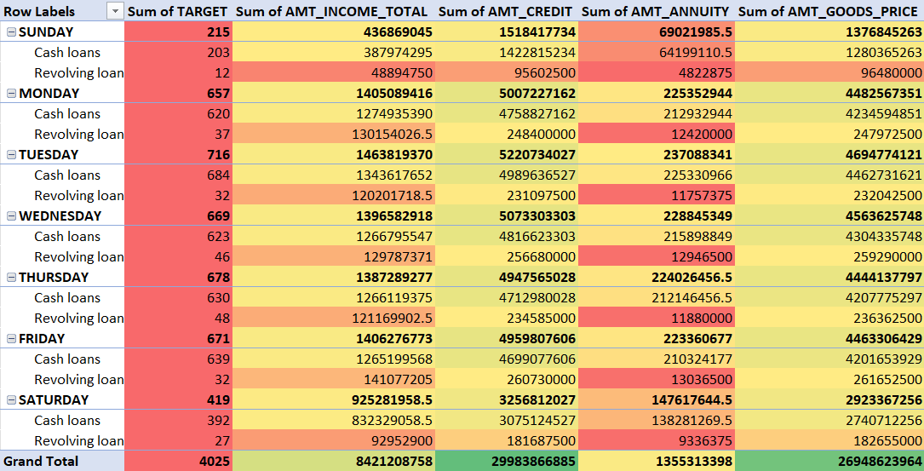
Performing Bivariate Analysis on application_data.csv
HEAT MAP

Slide 20
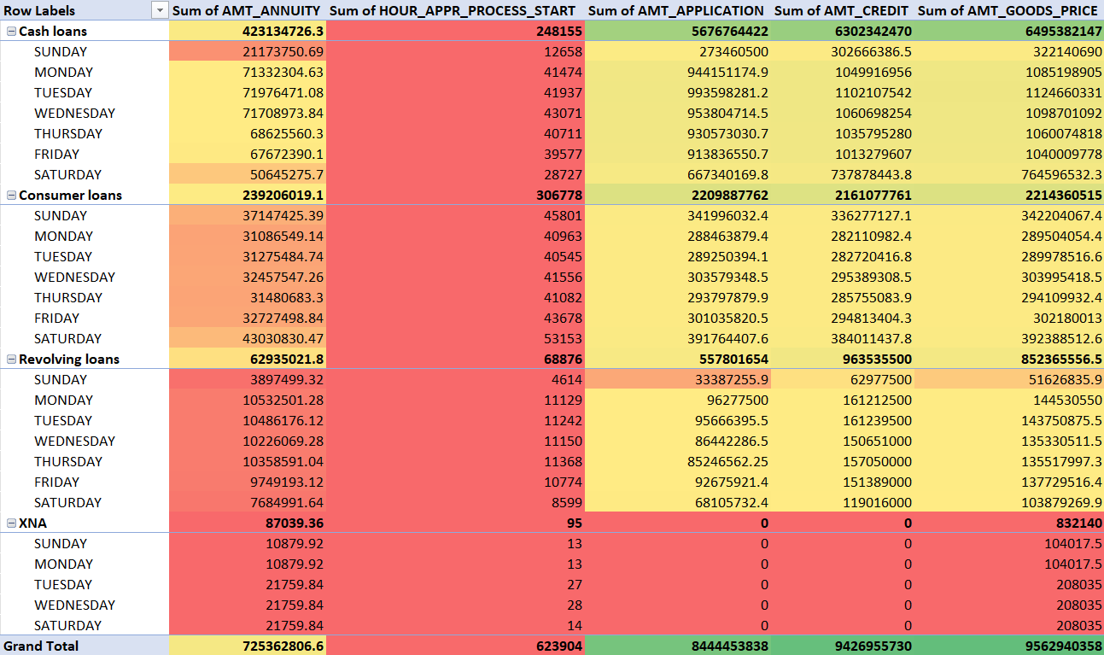
Performing Bivariate Analysis on previous_application.csv
HEAT MAP

Slide 21
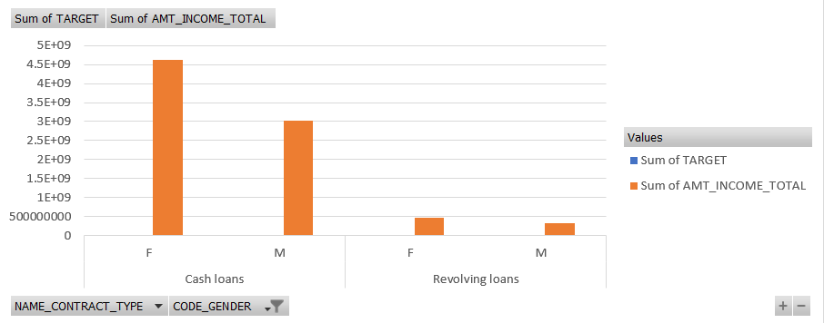
Create histograms, bar charts, or box plots to visualize the distributions of variables. Create stacked bar charts or grouped bar charts to compare variable distributions across different scenarios. Create scatter plots or heatmaps to visualize the relationships between variables and the target variable.
Data Visualization for
application_data.csv
previous_application.csv
Due to the absence of the target variable the pivot table was not made. The only visualization for the dependability between the variables was shown through the heatmap in the previous slide.

Slide 22
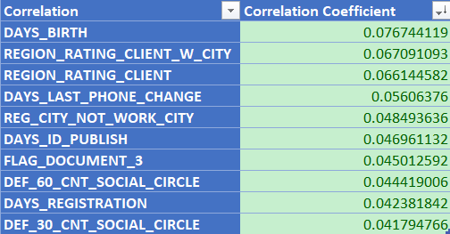
E. Identify Top Correlations for Different Scenarios:
Segment the dataset based on different scenarios (e.g., clients with payment difficulties and all other cases) and identify the top correlations for each segmented data using Excel functions.
Top 10 Correlated Variables of application_data.csv
Correlated Variables of previous_application.csv
Due to the absence of the target variable, there was no means to find out the correlation between the variables with the target variable.

Slide 23
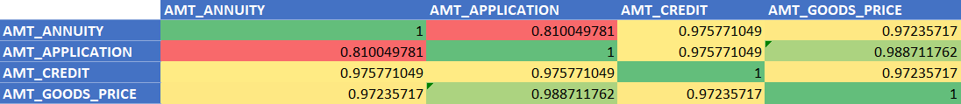
Create correlation matrices or heatmaps to visualize the correlations between variables within each segment. Highlight the top correlated variables for each scenario using different colors or shading.Data Visualization for
application_data.csv
previous_application.csv

Slide 24
Tech-Stack Used
Microsoft Excel: It is a spreadsheet program from Microsoft and a component of its Office product for business application. This enables users to format, calculate and organize data in a spreadsheet.
MS Excel Functions: They are predefined formulas that perform calculations by using specific values, called arguments, in a particular order or structure. Some of the functions are:
Text functions: clean(), substitute(), replace(), concatenate(), trim(), etc.
Mathematical and Statistical functions: sum(), sumif(), count(), max(), average(), median(), mode(), stdev(), etc.
Data Visualization in Excel: Bar, Column, Scatter, Heatmap, Stacked Chart, etc.

Slide 25
Insights
We were able to identify the missing data and performed descriptive statistics with it. This is necessary to ensure the accuracy of the analysis.
Identifying the Outliers in the dataset. They distort the results and can bring a significant impact to the analysis.
Analyzing the data imbalance. To check for biases in the dataset this is a necessary step to be undertaken.
Lastly performing the Univariate, Segmented Univariate, and Bivariate Analysis to gain factors driving for loan default.

Slide 26
Results
Remembering to adapt excel functions on specific dataset.
These learned insights helped me understand specific business questions which were addressed by MS Excel
Learning about Excel Text and Statistical functions. The importance of average(), median(),mode(), text() functions.
We were able to build different charts for visualization for answering the business questions. Some of the charts used were bar graph, stacked Chart and heatmap.
Achieving the ability to learn and write MS Excel functions to execute different business questions.
Solving Company related problems using different visualization charts offered by Excel

